Slide 1
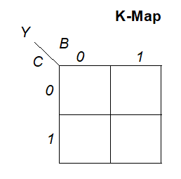
Use K-Maps to see theorems
Number | Theorem | Name
T9 | B• (B+C) = B | Covering
0 1
0 1

Slide 2
Use K-Maps to see theorems
Number | Theorem | Name
T10 | (B•C) + (B•C) = B | Combining
0 1
0 1

Slide 3
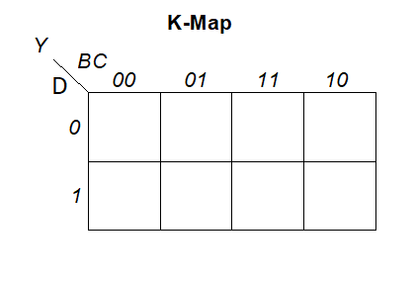
Use K-Maps to see theorems
Number | Theorem | Name
T11 | (B•C) + (B•D) + (C•D) = (B•C) + (B•D) | Consensus
0 0 1 0
1 1 1 0

Slide 4
Quine–McCluskey algorithm
The Quine–McCluskey algorithm (QMC), also known as the method of prime implicants, is a method used for minimization of Boolean functions with n variables
The Quine–McCluskey algorithm is functionally identical to Karnaugh mapping, but the tabular form makes it more efficient.

Slide 5
MULTILEVEL COMBINATIONAL LOGIC
Logic in SOP/POS form is called two-level logic.
Designers often build circuits with more than two levels of logic gates.
These multilevel combinational circuits may use less hardware than their two-level counterparts.
Bubble pushing is especially helpful in analyzing and designing multilevel circuits.

Slide 6
MULTILEVEL COMBINATIONAL LOGIC
For example, consider building a three-input XOR using the two-level techniques we have studied.

Slide 7
MULTILEVEL COMBINATIONAL LOGIC
3-input XOR

Slide 8
MULTILEVEL COMBINATIONAL LOGIC

Slide 9
MULTILEVEL COMBINATIONAL LOGIC
Domande:
quante porte AND servono per fare uno XOR ad 8 ingressi utilizzando una rete AND/OR a 2 livelli?
Quanti ingressi hanno le AND
Quanti ingressi ha l’OR che raccoglie le uscite degli AND?

Slide 10
Combinational Building Blocks
Multiplexers
Decoders

Slide 11
Multiplexer (Mux)
Selects between one of N inputs to connect to output
log₂N-bit select input – control input
Example: 2:1 Mux
Y = SD₀ +SD₁

Slide 12
Multiplexer Implementations
Logic gates
Sum-of-products form
Tristates
For an N-input mux, use N tristates
Turn on exactly one to select the appropriate input

Slide 13

Multiplexer a 4 ingressi
I multiplexer a 4 ingressi possono essere realizzati a partire da quelli a 2 ingressi:
S₀
D₀
S₁ S₀ Y
0 0 D₀
0 1 D₁
1 0 D₂
1 1 D₃
S₁
D₁
S₀
Y
D₂
D₃

Slide 14
MUX
Domande:
quante porte AND servono per fare un MUX ad 8 ingressi utilizzando una rete AND/OR a 2 livelli?
Quanti ingressi hanno le AND ?
Quanti ingressi ha l’OR che raccoglie le uscite degli AND?

Slide 15
Logic using Multiplexers
Using mux as a lookup table

Slide 16
Logic using Multiplexers
Reducing the size of the mux

Slide 17
Teorema di shannon
Data una funzione booleana f di n variabili vale l'uguaglianza:
possiamo utilizzare questo teorema per realizzare una funzione di n variabili usando un MUX e 2 funzioni da n-1 variabili

Slide 18
Es. sintesi con mux
Si progetti un circuito che realizza la funzione descritta dalla tabella della verità utilizzando MUX a 2 ingressi come componenti elementari

Slide 19
Es. sintesi con mux
A₀
0
0
0
1
0
0
1
0
A₁
A₂
D
A₁

Slide 20
Es. sintesi con mux
A₁
0
A₂
A₀
D
A₁
0
A₀

Slide 21
Decoders
N inputs, 2^{N} outputs
One-hot outputs: only one output HIGH at once

Slide 22
Decoder Implementation

Slide 23
Logic Using Decoders
OR minterms

Slide 24
Timing
Delay: time between input change and output changing
How to build fast circuits?

Slide 25
Propagation & Contamination Delay
Propagation delay: t_{pd} = max delay from input to output
Contamination delay: t_{cd} = min delay from input to output

Slide 26
Propagation & Contamination Delay
Delay is caused by
Capacitance and resistance in a circuit
Speed of light limitation
Reasons why t_{pd} and t_{cd} may be different:
Different rising and falling delays
Multiple inputs and outputs, some of which are faster than others (see next slide)
Circuits slow down when hot and speed up when cold

Slide 27
Critical (Long) & Short Paths
Critical (Long) Path: t_{pd} = 2t_{pd_AND} + t_{pd_OR}
Short Path: t_{cd} = t_{cd_AND}

Slide 28
Fine lezione
Per la prossima lezione:
Studiare paragrafi 4.1 4.2, 4.3 e 4.5 del libro

